Slide 1
Supplier SIM Process Quick Guide Coupa – Allegro Microsystems
6-19-24
Supplier Required Action Steps

Slide 2
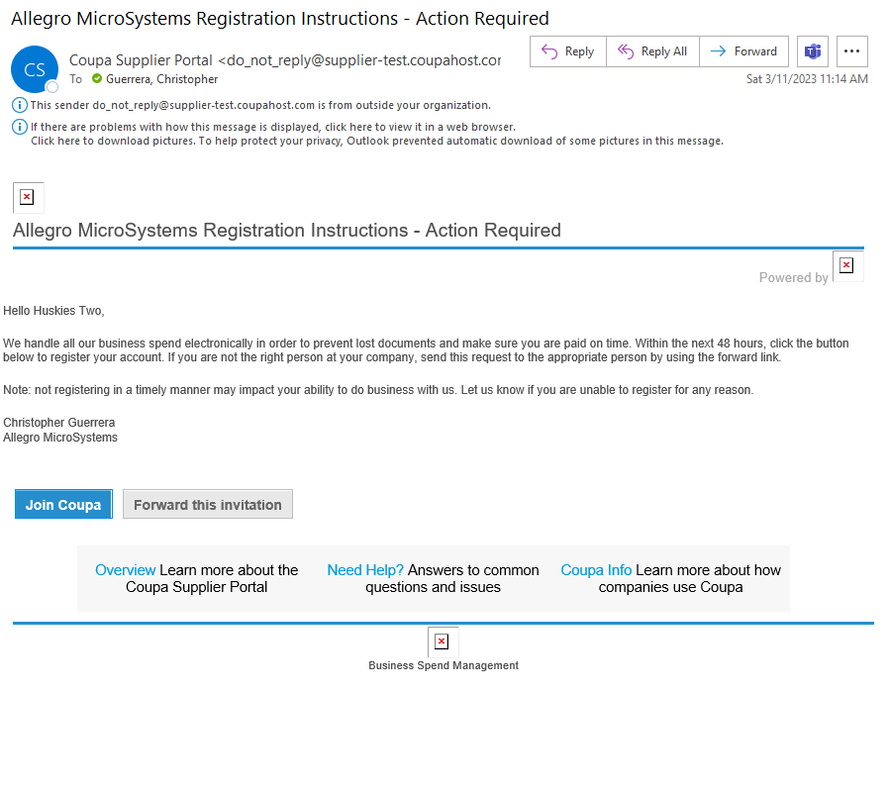
Accepting the Coupa Supplier Portal Invitation Link
Allegro Microsystems will send the Coupa Supplier Portal Invitation Link to your email address to link
After selecting “Join Coupa’ the supplier will create the login and password for the Coupa Supplier Portal
Supplier will select “Join Coupa” in the email that will allow for their team to join the Coupa Supplier Portal to link with Allegro Microsystems

Slide 3
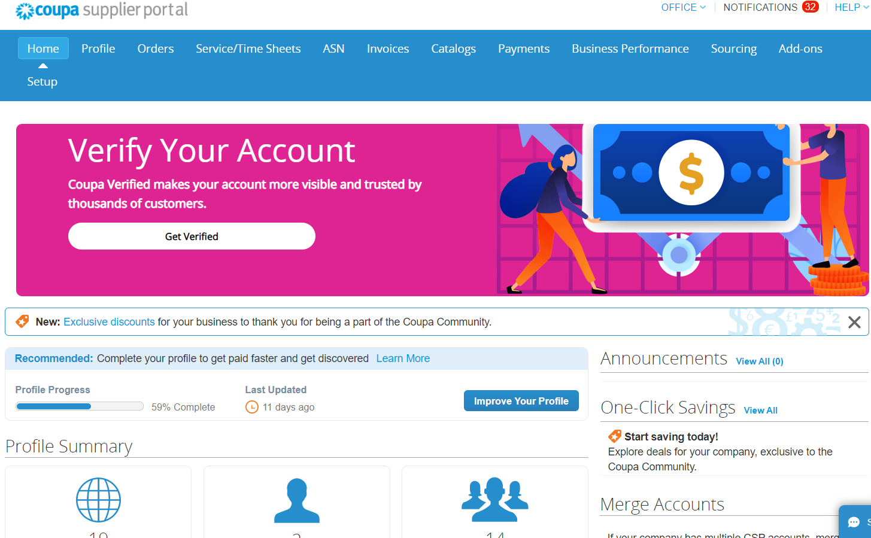
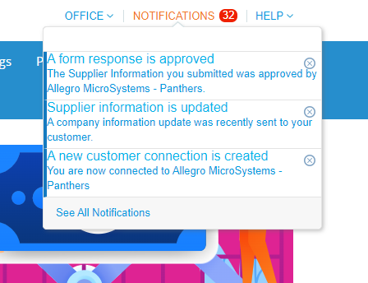
Accessing the SIM 2 Information Request Form (Onboarding Process)
Supplier will select link “Update your profile for Allegro Microsystems” to begin completing the SIM 2 Information Request Form
Login to the Coupa Supplier Portal with email and password
Supplier will go to the notifications section in the top right of the Coupa Supplier Portal

Slide 4
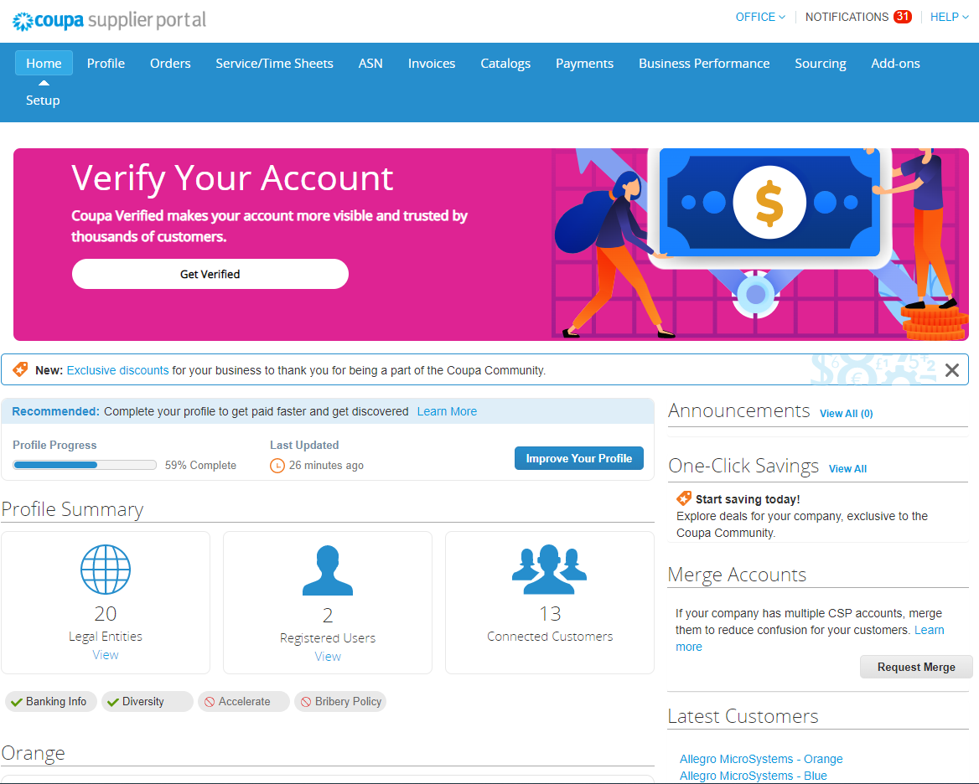
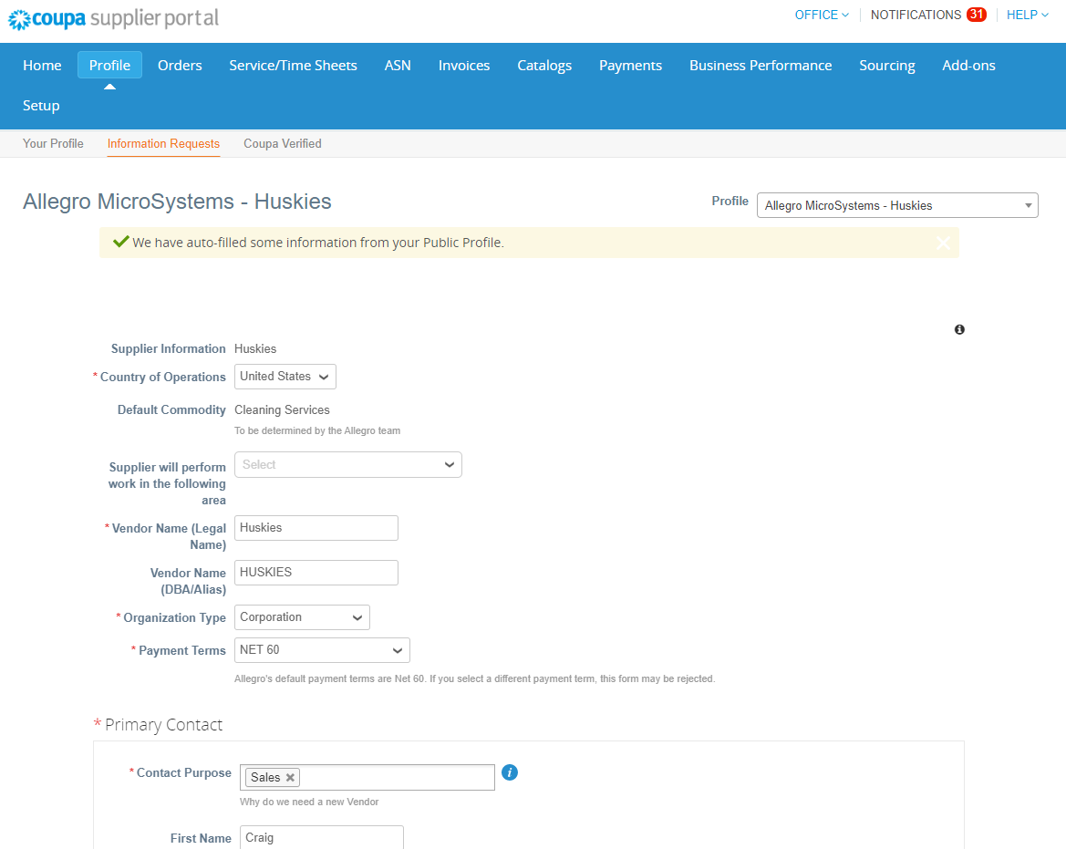
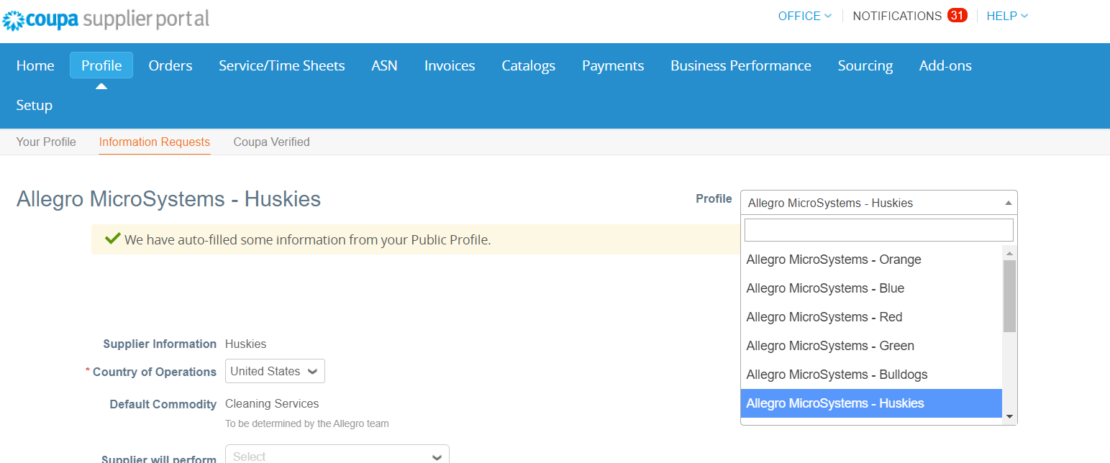
Accessing the SIM 2 Information Request Form (Alternative Option)
Login to Coupa Supplier Portal with email and password
Select “Profile” next to Home in the blue bar & select “Information Requests” highlighted in Orange above
Make sure the “Profile” drop down has the correct customer selected

Slide 5
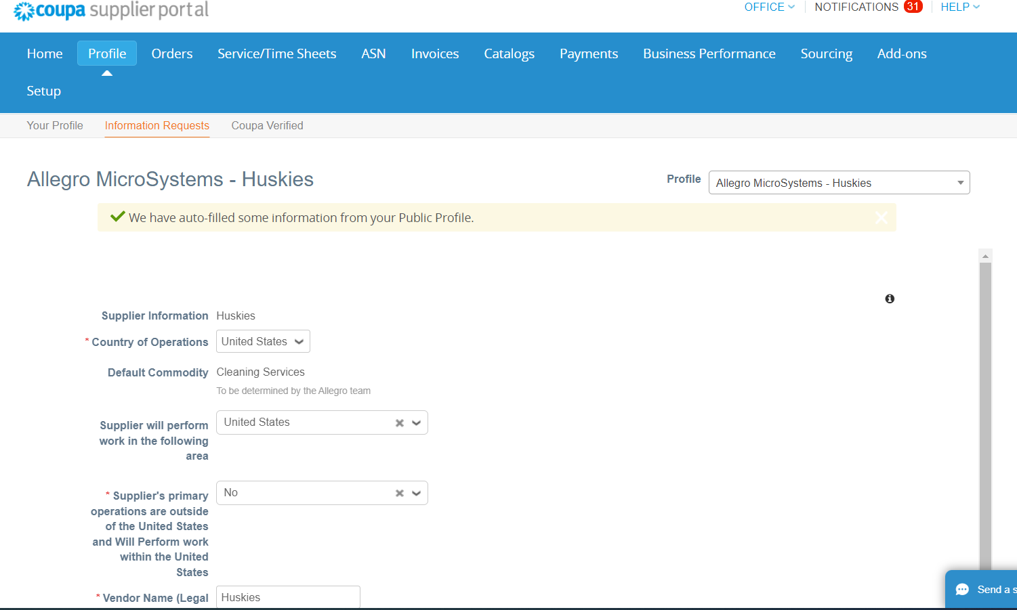
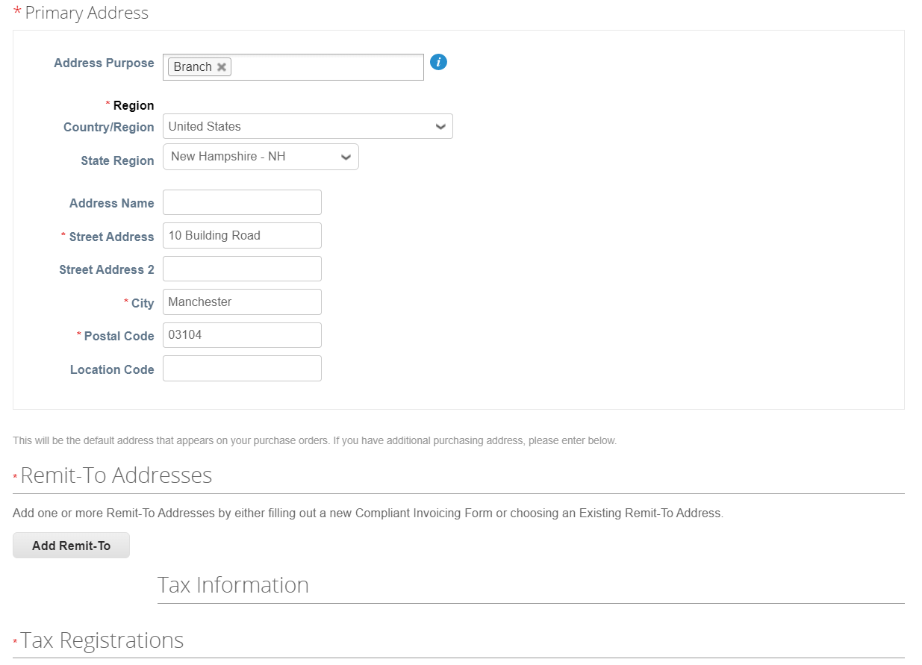
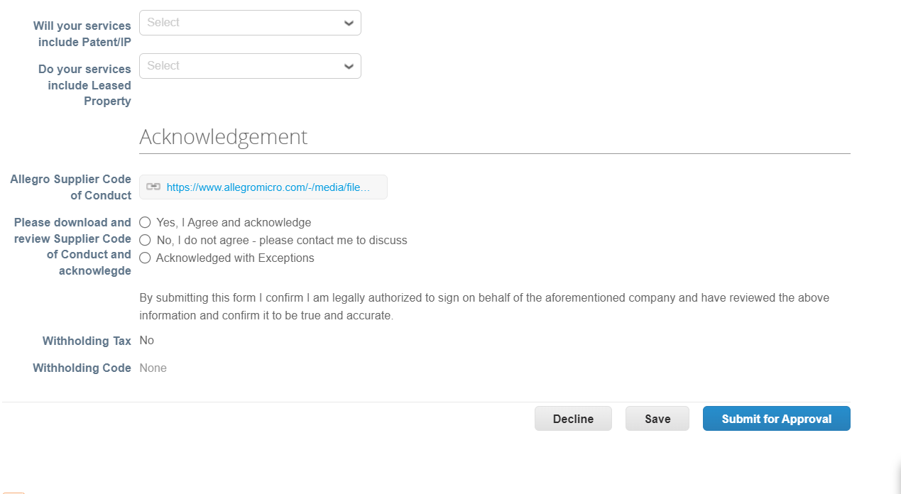
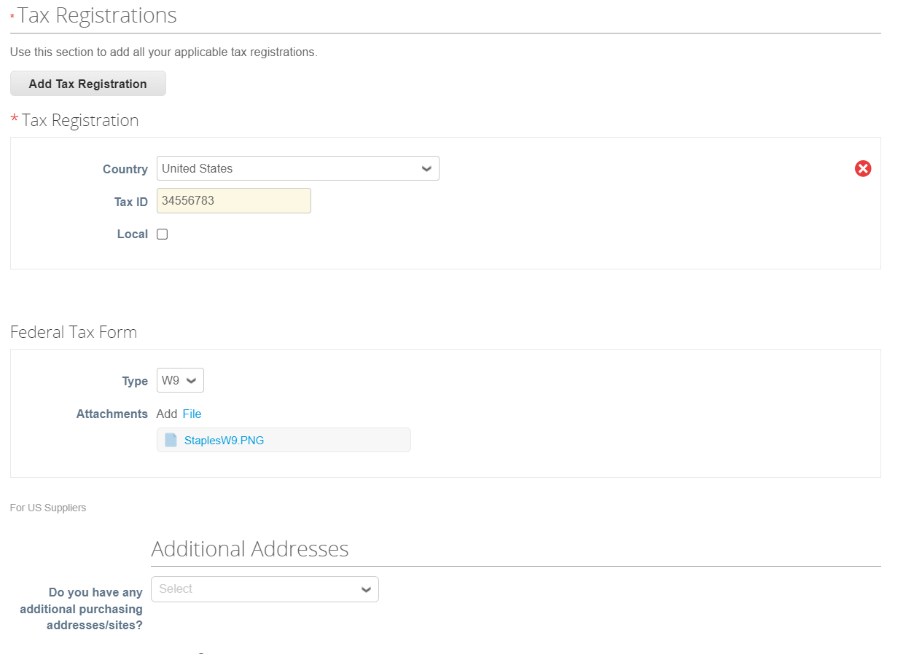
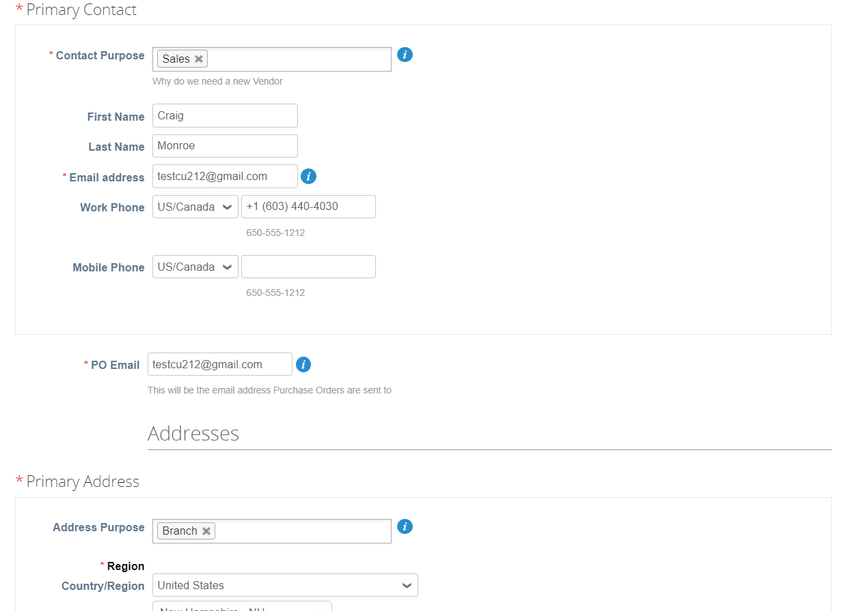
Completing the SIM 2 Information Request Form
Next Slide for “Add Remit-To” Section
Complete Remit To Address page by selecting “Add Remit-To” (See Next Page for reference)
Complete each section on the SIM 2 Information Request with required information
Must select “United States” for Supplier Will Perform Work in the Following Area to generate Tax Identification Information below (W8/W9 attachment)
Add Primary Contact, & Primary Address for your facility
Enter the Tax Registration Information & Attach W8/W9 for the Federal Tax Form section
Once all information has been updated, scroll to the bottom of the form and submit for approval – Allegro Microsystems will receive the form back for approvals and processing

Slide 6
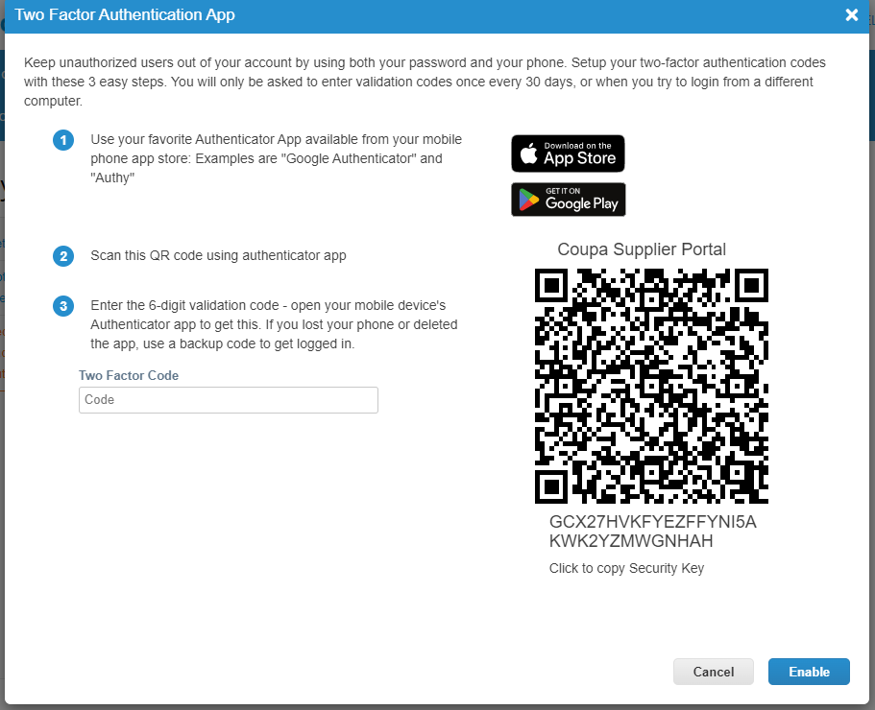
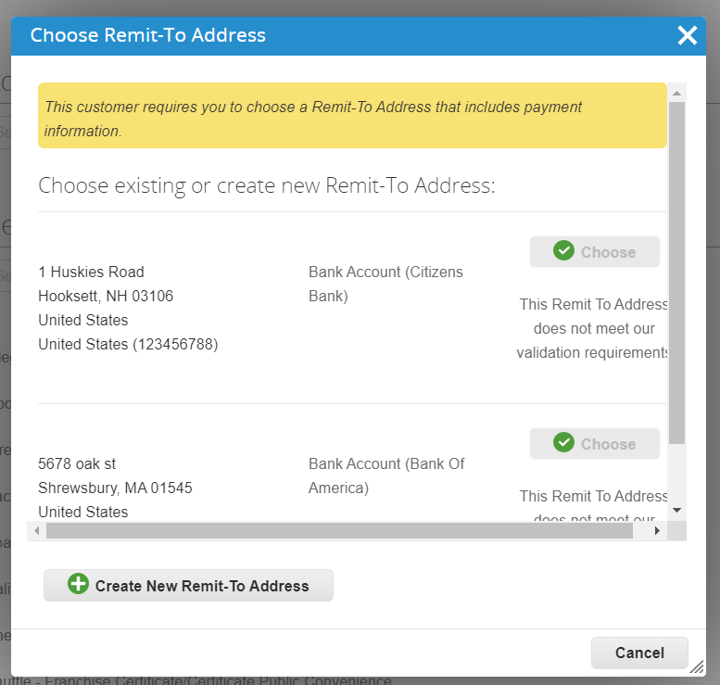
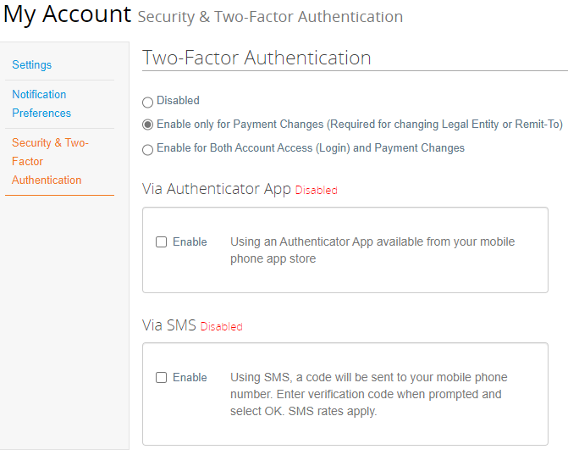
Two Factor Authenticator – Security
Next Slide for “Add Remit-To” Section
Next the Two Factor Authentication Request will generate. Download the “Microsoft Authenticator Application” located under the App Store on your mobile device and take a photo of the QR Code below to enter the 6 Digit Code required
When completing the Remit To Address section, select the button “Add Remit To”
On the Two Factor Authentication under Settings, please enable for “Payment Changes”
Next select “Create New Remit To Address”
Once these steps are completed, the Two Factor Authenticator will be established for security & you can select “Add Remit To” again to continue completing the Remit To Address section

Slide 7
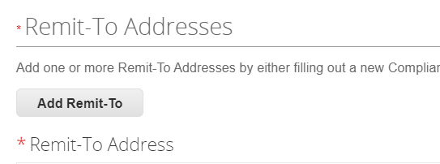
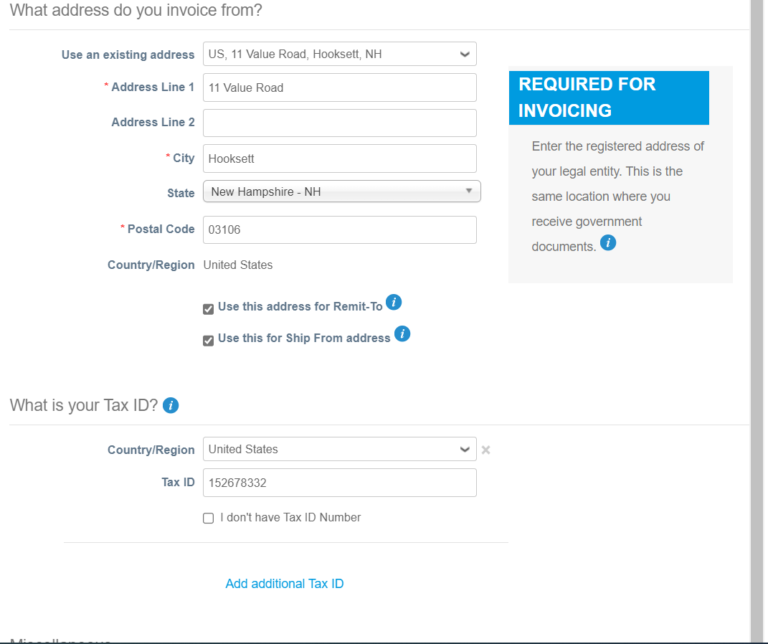
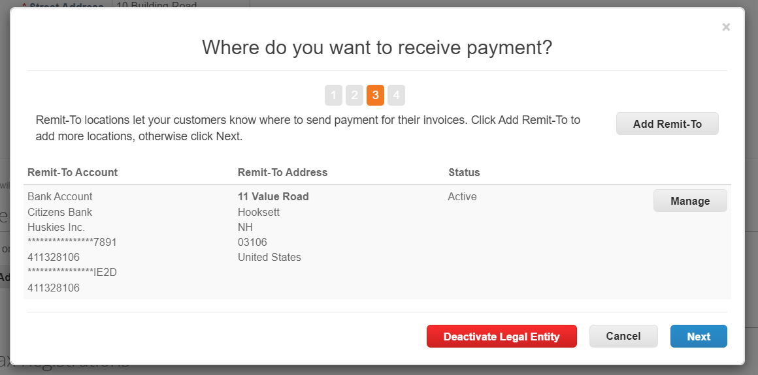
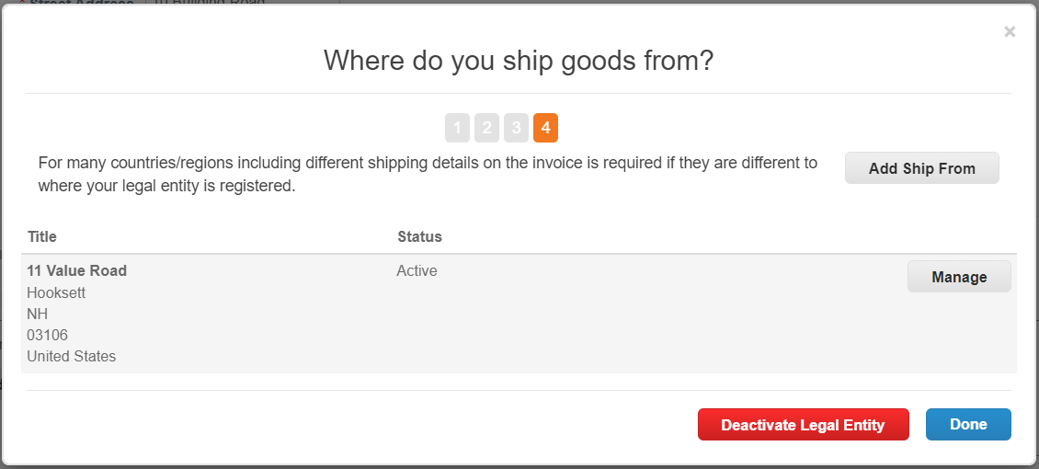
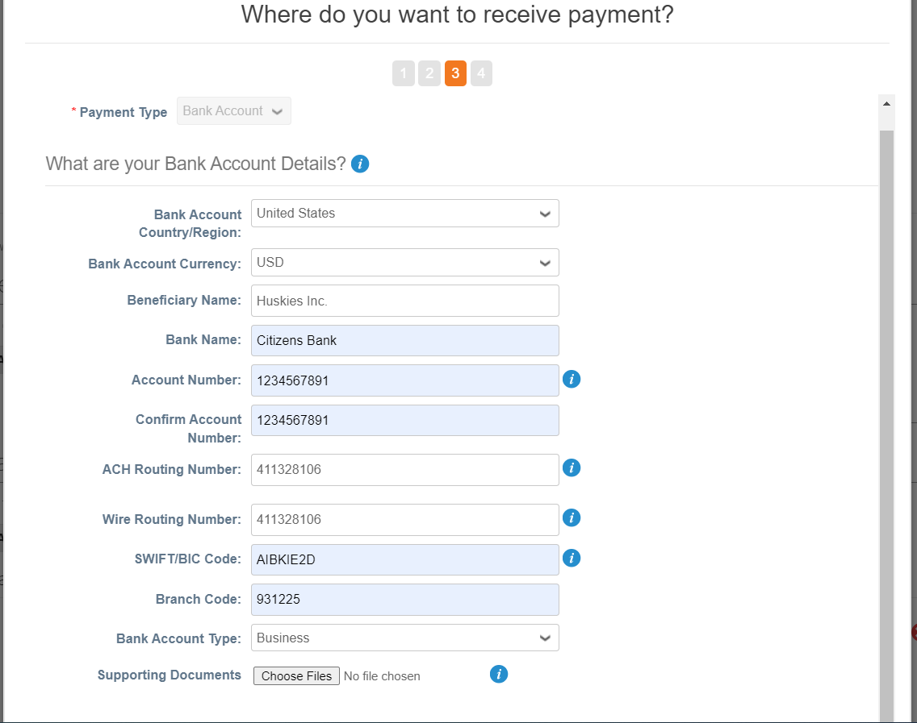
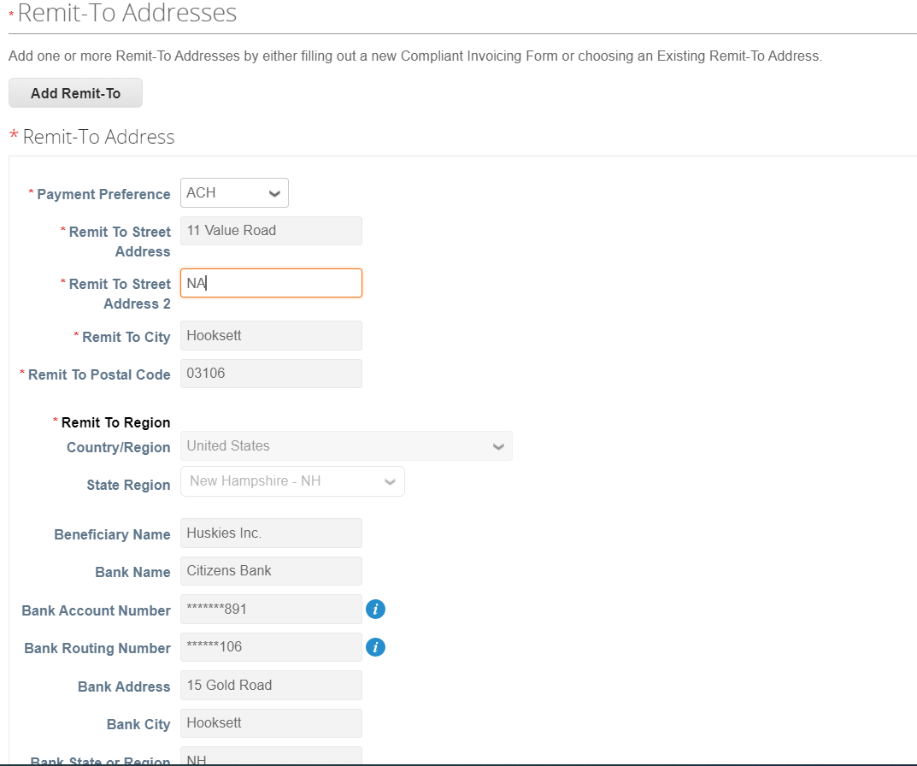
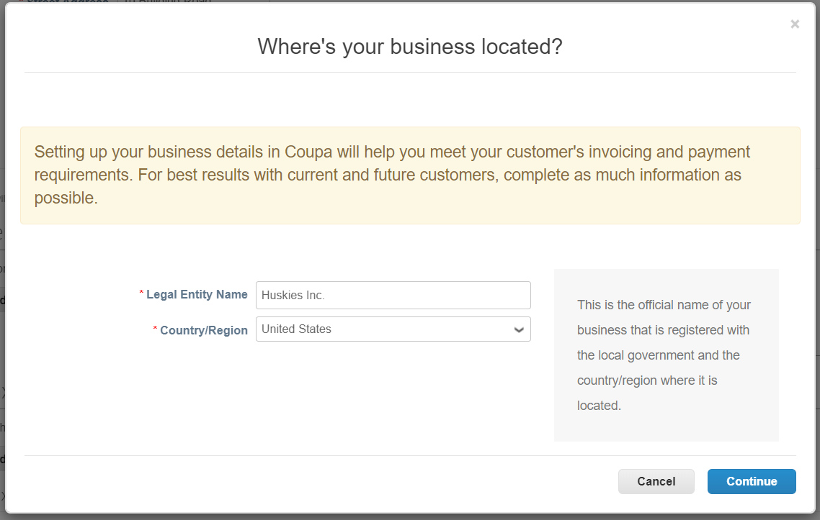
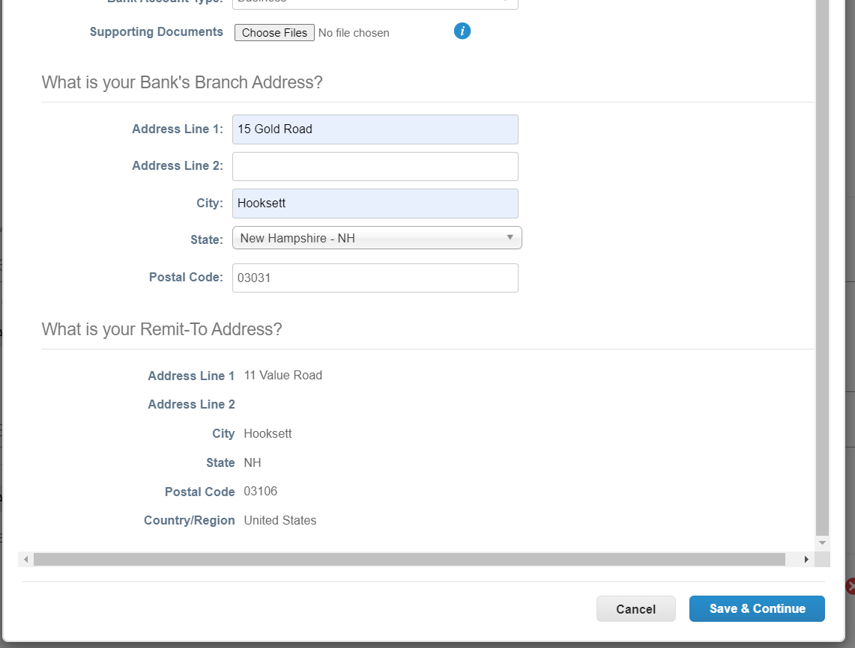
“Add Remit-To” Section
Select “Done”
Select “Add Remit-To”
Enter Address you Invoice from & Tax ID
Select “Done”
Select “Create New Remit-To Address”
Select “Add Now”
Enter Bank Account Details and Bank Address below
Enter “ACH” for Payment Preference & enter “NA” for Remit To Street Address 2
Enter the Legal Entity Name & Country/Region for your facility

Slide 8
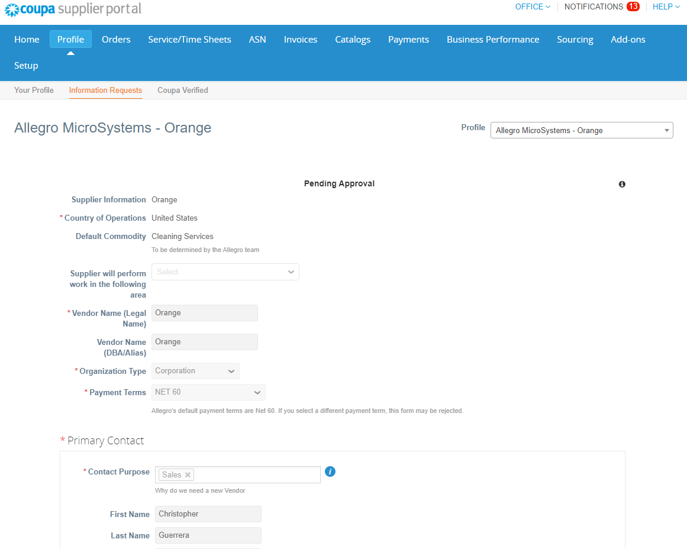
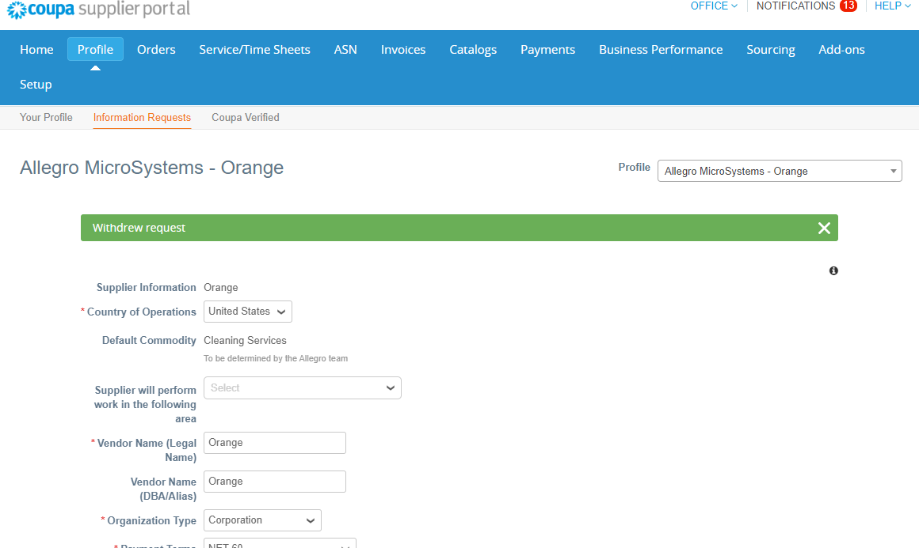
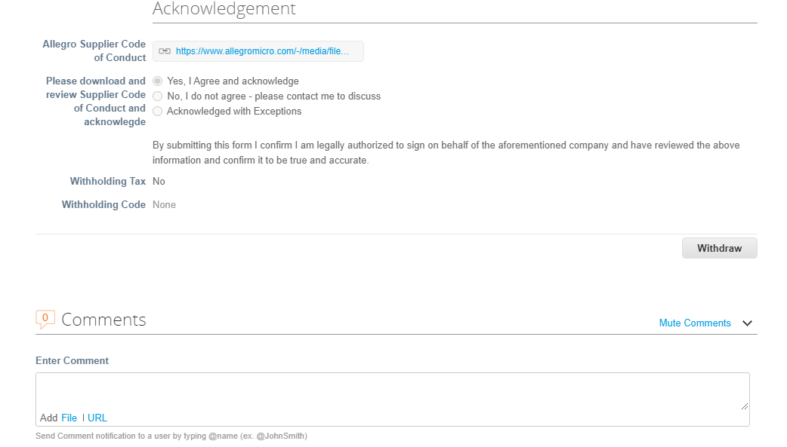
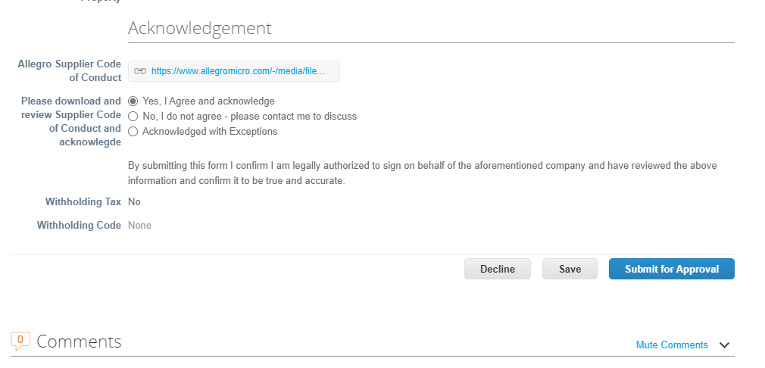
Do You Need to Edit the SIM 2 Information Request Form already submitted?
Option 1 - If the SIM 2 form has already been submitted & requires editing, scroll to bottom of the form & select “Withdraw”
This will allow for the form to become editable for updates
Green notification at top of screen will pop-up once the form has been “Withdrawn” successfully
Option 2 – If the SIM 2 form has been rejected by the US Treasury team, form will be editable once opening the form again
Open the SIM 2 form & begin editing the form
Scroll to the bottom of the form & select Submit for Approval to have this processed by Allegro

Slide 9
Supplier Landing Page: Suppliers | Allegro MicroSystems Coupa Frequently Asked Questions: https://supplier.coupa.com/help/faqs/ Coupa Procurement Contact coupaprocurement@allegromicro.com

