Slide 1
Primary Quick Guide
Coupa – Allegro Microsystems
06-19-24
Supplier Enablement

Slide 2
Accessing Coupa Supplier Portal
Access Coupa Supplier Portal – Username, Settings, Activity, & Inbox
Select Home page to review Profile Summary
Review Notifications
for recent
updates in
system
Review Open Orders
Review Invoices
Review Payments
Review Sourcing
Review Setup Overview
Profile Summary shows Registered Users, Connected Customers, Legal Entities

Slide 3
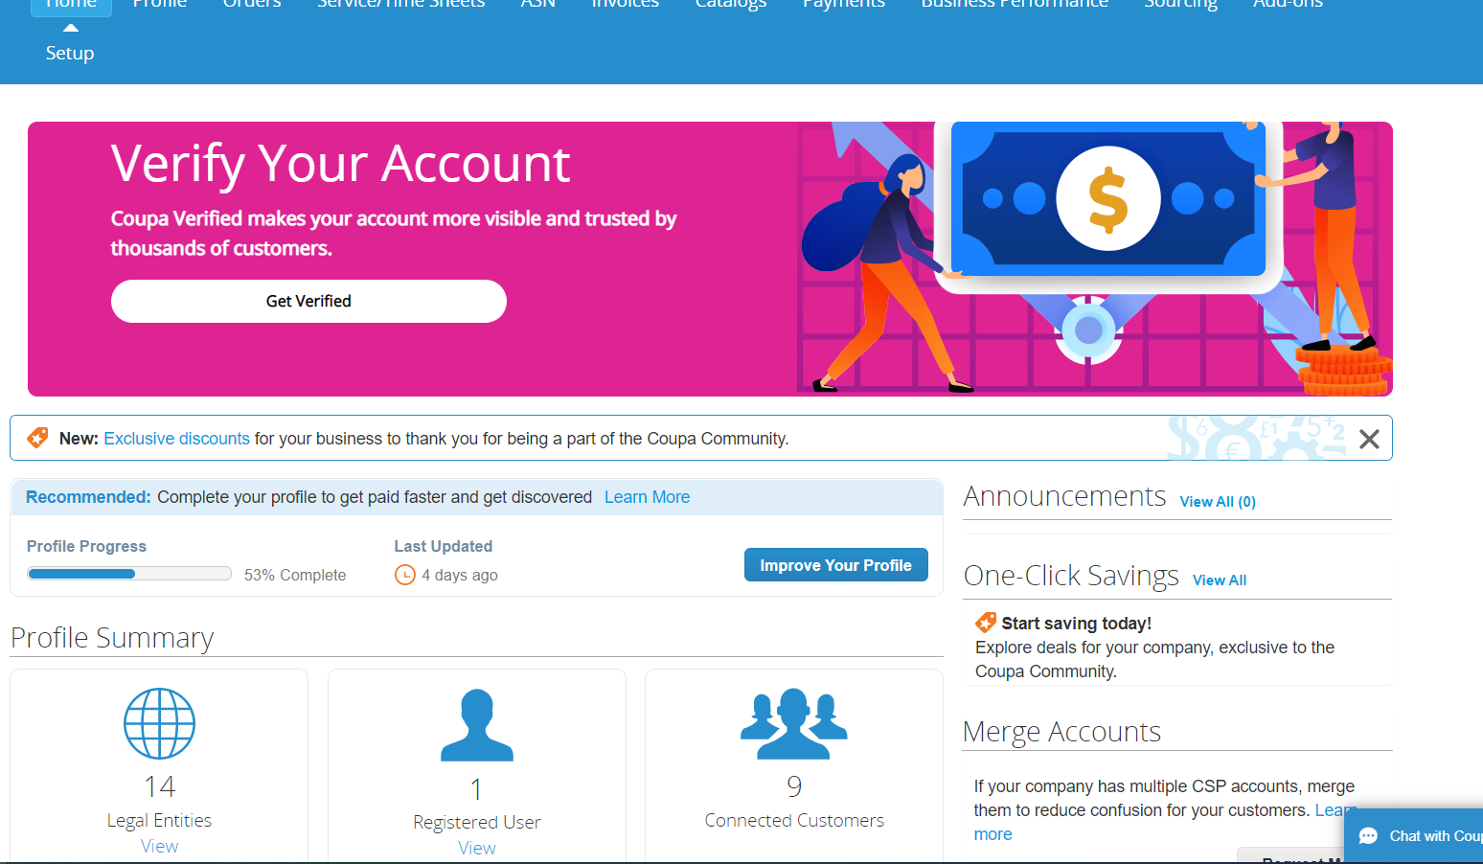
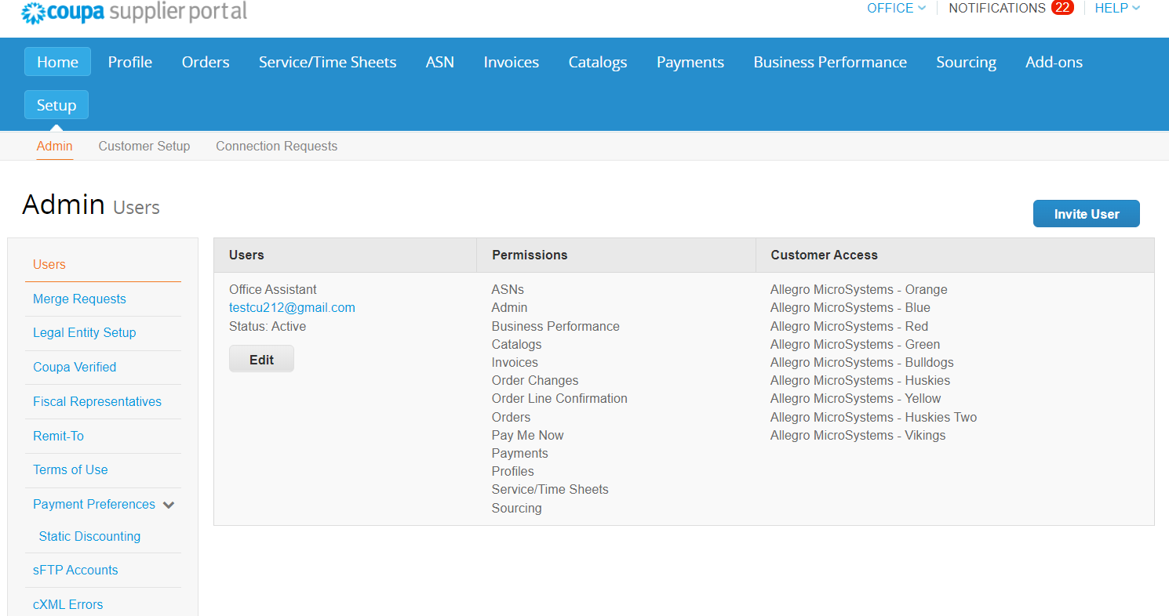
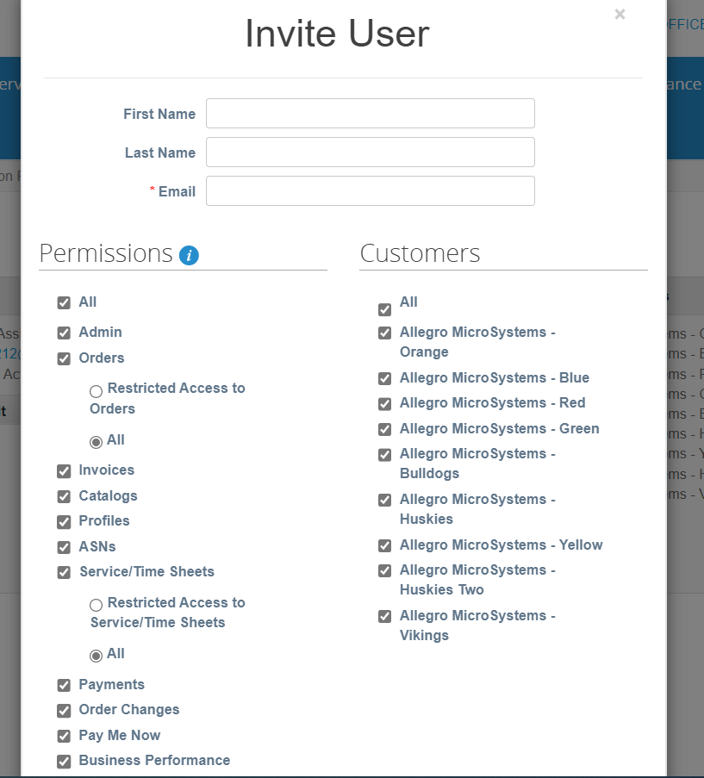
Active User
Supplier can select “View” under Registered User to send invite to add individuals to Active User List
Supplier will select Invite User to send the Coupa Supplier Portal Invitation
Supplier will add the First Name, Last Name and Email Address applicable and select send at the bottom of the Invite User form

Slide 4
Managing Purchase Orders
Access the Orders page to manage Purchase Orders
Use Purchase Order Summary to review PO Number, Order Date, Status, Items, Review Acknowledged At, Total and Actions
Ship Date vs. Delivery Date
Delivery Date = Promise Date (The date that suppliers will deliver this product to Allegro)
(Delivery date is not a supplier’s Ship Date)
Select the View section from purchase order views to show different order statuses
Select the purchase order number to review order details

Slide 5
Acknowledge Purchase Orders
Ship Date vs. Delivery Date
Delivery Date = Promise Date (The date that suppliers will deliver this product to Allegro)
(Delivery date is not a supplier’s Ship Date)
Select purchase
order to confirm acknowledgement
“Do not acknowledge a PO until the supplier agrees to “ALL” of the terms on the order including Need By Date, Delivery Date, Quantity, Parts, Price per Each Line
If the supplier “Does Not Agree”, leave comment for the buyer in the comments section

Slide 6
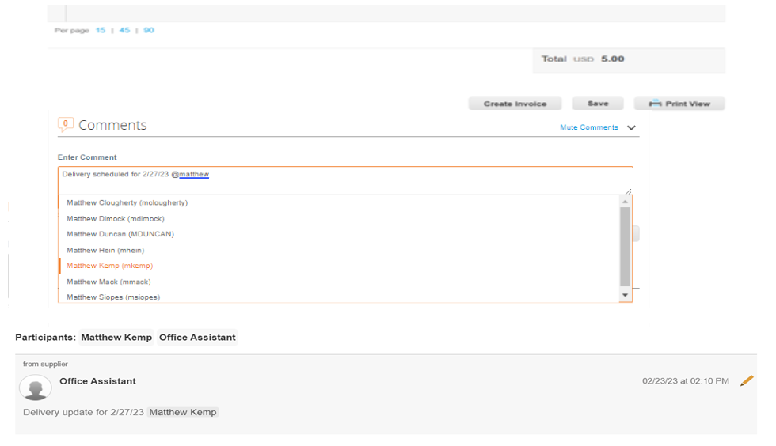
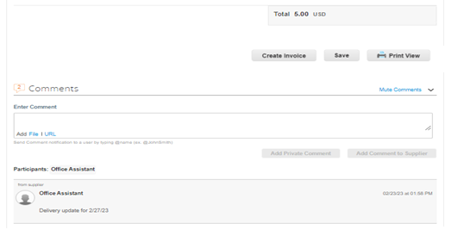
Supplier Comments on Purchase Order
CORRECT
INCORRECT
-Incorrect way to comment by not adding the buyer’s name onto your message
-This shows the supplier as the only participant in the conversation
-Correct way to add a comment by including “@buyer” Example - @MatthewKemp in your message
-Make sure to comment to the buyer that is listed on your PO
-Supplier tags the Allegro Buyer in comment section to ensure communication with Allegro Procurement Team

Slide 7

On Time Delivery
It is the Supplier’s responsibility to track their open orders with Allegro
Your goal is to delivery every order per the original delivery dates provided when the order was acknowledged
Allegro tracks their orders very closely and any delay can lead to a much longer delay to our production lines and lost customer business.
New business opportunities will be awarded based on each suppliers on time delivery performance throughout the year.
If scenario occurs when there is no way to meet your commitment per the original delivery date, then the buyer should be notified immediately with additional details
Our Promise Date is the Delivery Date (Delivery date is not the supplier’s Ship Date)

Slide 8
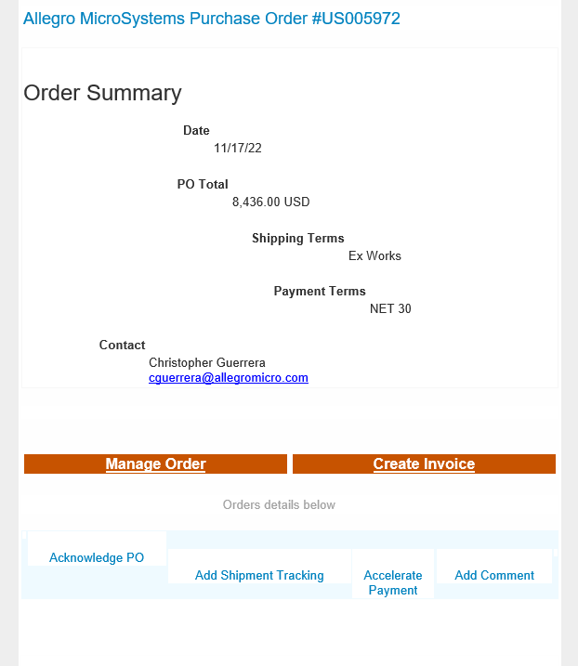
Create Coupa Invoices
CSP
Select the Gold Coins to generate an Invoice
Select order from the purchase order page
Select the Red Coins to generate a
Credit Note
SAN
Purchase Orders are emailed (SAN), supplier will access the PO email and select Create Invoice
Select here to Create Invoice

Slide 9
Upload Invoices
Verify Remit To information is accurate
Verify all invoice information is correct

Slide 10
Submit Invoices
Select send Invoice
If the Finance Contact, who will be submitting Invoices through Coupa, can’t see Allegro’s Coupa Account, please contact your Allegro buyer for assistance
Select submit Invoice

Slide 11
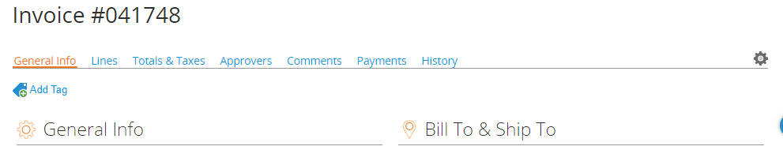
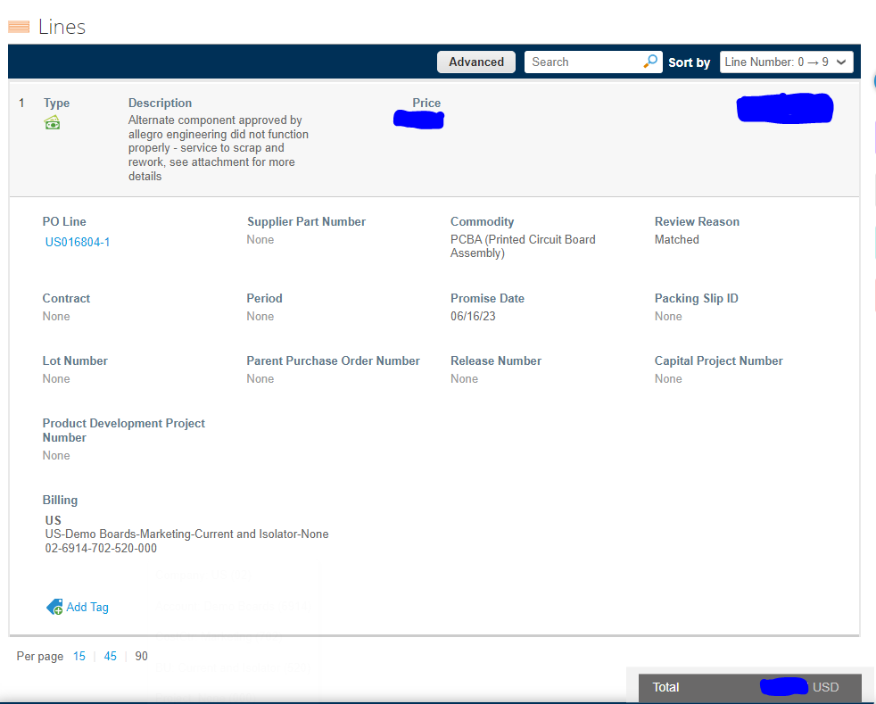
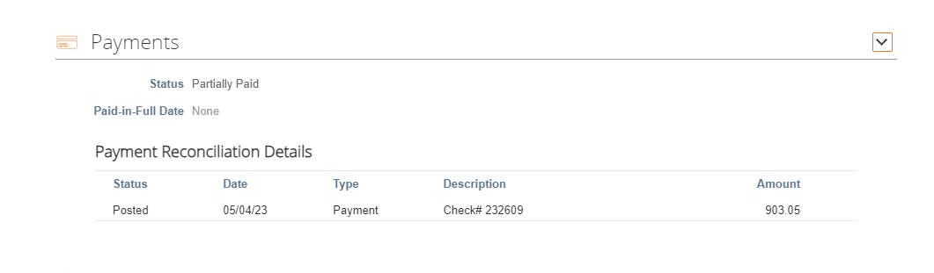
Invoice Payment Confirmation
Supplier will go to the Invoice tab in the Coupa Supplier Portal to select the Invoice applicable for that Purchase Order
Invoice Number located at the top of the page once selected
Invoice Number located at the top of the page once selected
Supplier will scroll down through the Invoice to the “Payments” section located below the comments section found at the bottom of the invoice document
Must scroll to the bottom of the page “Payments”
Supplier will select “Payments” to receive the invoice status within the Coupa Supplier Portal
The Payments section will have payment Status, Date, Type, Description and the Total Amount

Slide 12
Access Invoices page from the Coupa home to review all invoices
Email notifications will be sent from Coupa

Slide 13
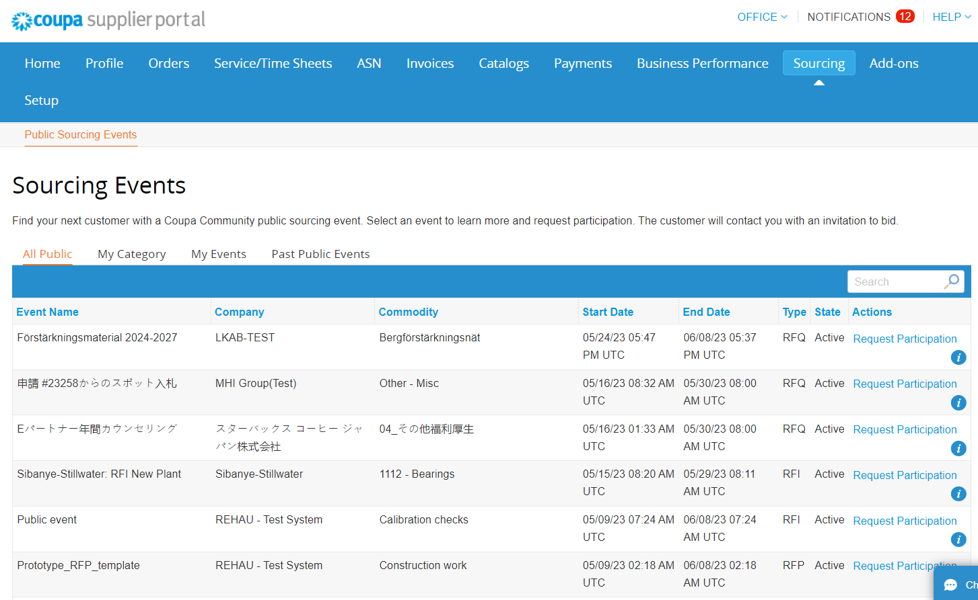
Sourcing Module - CSP
Coupa Supplier Portal is a tool to manage quoting throughout the Sourcing Events
Accessing public sourcing events is an important way that supplier can find new business & have full visibility in the CSP on their quoting process
Supplier can access the Sourcing Module tab to review, confirm and participate in any upcoming sourcing event
All Public: Displays all active sourcing events
My Category: Displays all events in the categories selected in the supplier’s Product and Service Categories section of their profile
My Events: Displays all events the supplier is participating in
Past Events: Displays all past events the supplier has participated in

Slide 14
Supplier Landing Page:
Suppliers | Allegro MicroSystems
Coupa Frequently Asked Questions: https://supplier.coupa.com/help/faqs/
Coupa Procurement Contact coupaprocurement@allegromicro.com

